Slide 1
Identifying genomic markers of drug response (an analysis in R)
ICR Bioinformatics introduction
3rd June 2015

Slide 2
Overview
Get your data sets
Explore the data
Analyse and visualise

Slide 3
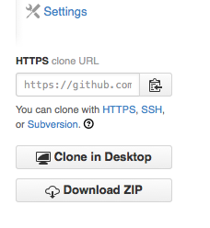
Download from share or Github
Genomics of Drug Sensitivity in
Cancer (cancerrxgene.org)
Browse to https://github.com/DrJCampbell
Look for genexdrugdemo project
Download all files to a local directory
git clone \
https://github.com/DrJCampbell/genexdrugdemo.git
Or you can get the zip file

Slide 4
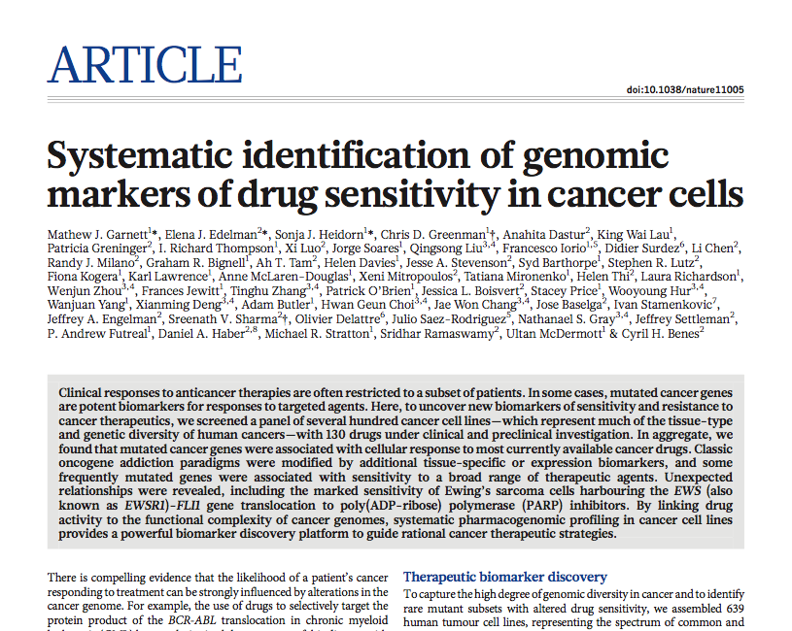
The data set
PMID: 22460902
What Garnett et al. did
Mutation, CNA and expression
IC50 estimates for compounds
MANOVA, elastic net
Gene-drug associations

Slide 5
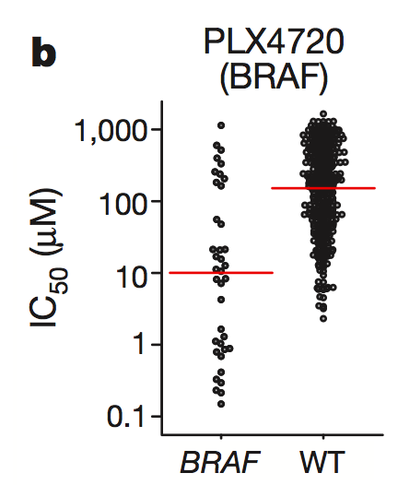
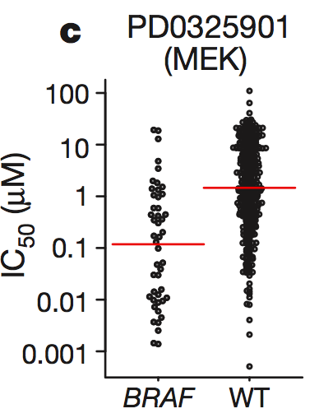
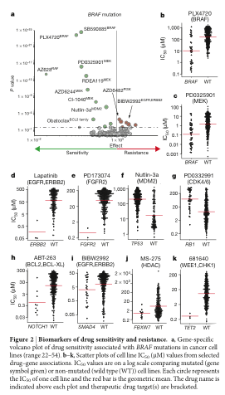
Garnett et al., 2012
Results examples

Slide 6
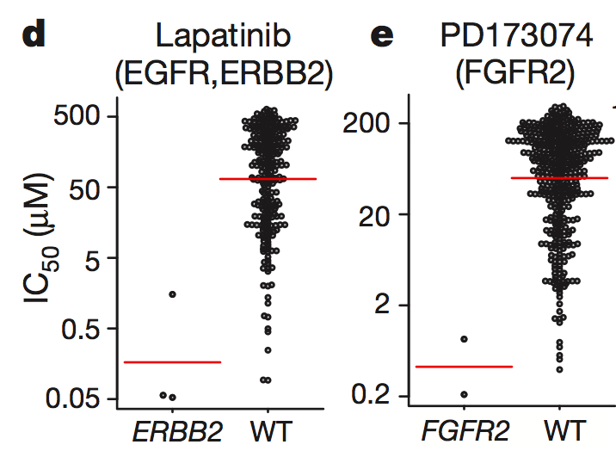
Garnett et al., 2012
Results examples

Slide 7
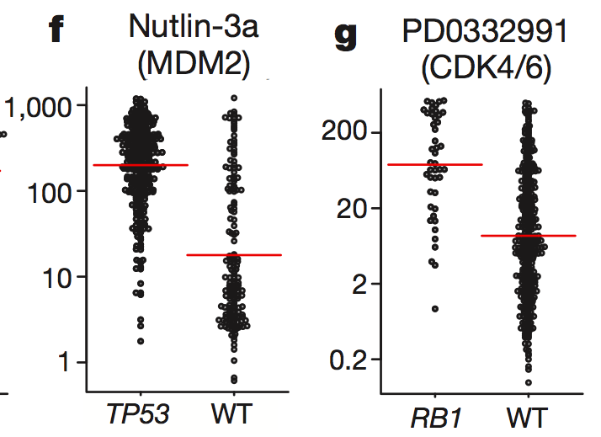
Garnett et al., 2012
Results examples

Slide 8
Explanation for examples
Massively simplified
RTK
Lapatinib (EGFR)
PD173074 (FGFR)
MDM2
Nutlin
RAS
TP53
RAF
PLX4720
CycD+CDK4/6
PD0332991
MEK
PD0325901
RB1
ERK
E2F

Slide 9
Overview of Our Analyses
Steps in R
Set up (load functions, set dir)
Load data sets and check them
Test a single association
Test all associations
Visualise the results

Slide 10
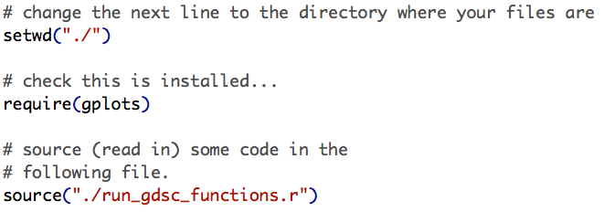
Analysis Stage 1a
Set up, load data and take a look
Set the working directory, load modules and predefined functions

Slide 11
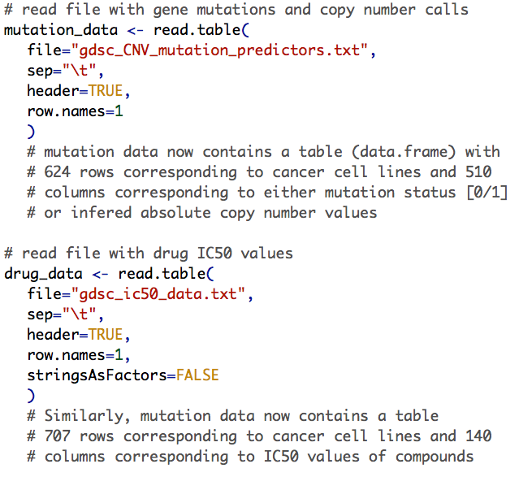
Analysis Stage 1b
Set up, load data and take a look
Read the mutation data table
Get a 624 x 510 element table
Read the drug IC50 data table
Get a 707 x 140 element table

Slide 12
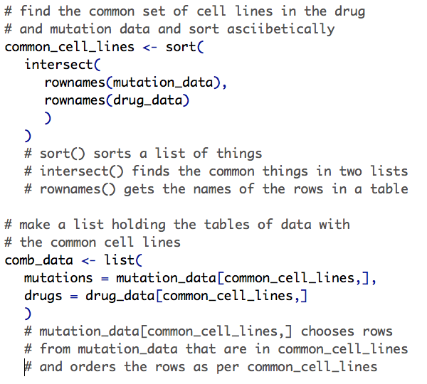
Analysis Stage 1c
Set up, load data and take a look
Get a list of cell lines in both tables (common row names)
Organise the data tables with common rows…

Slide 13
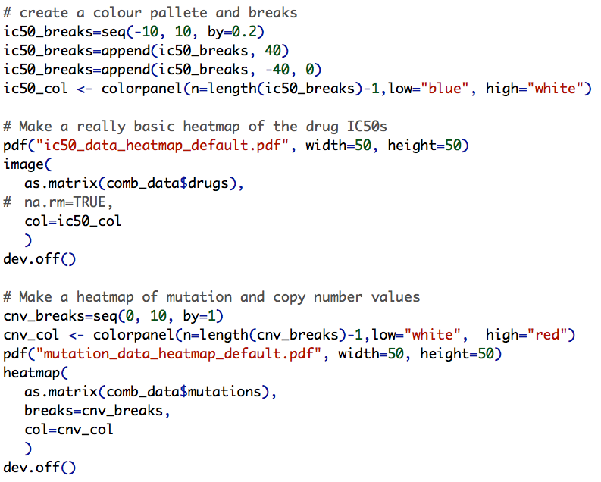
Analysis Stage 1d
Set up, load data and take a look
Define a colour palette and break points
Make a simple heatmap of IC50 values with image()
A fancier heatmap for the mutation data set

Slide 14
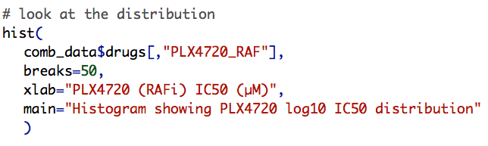
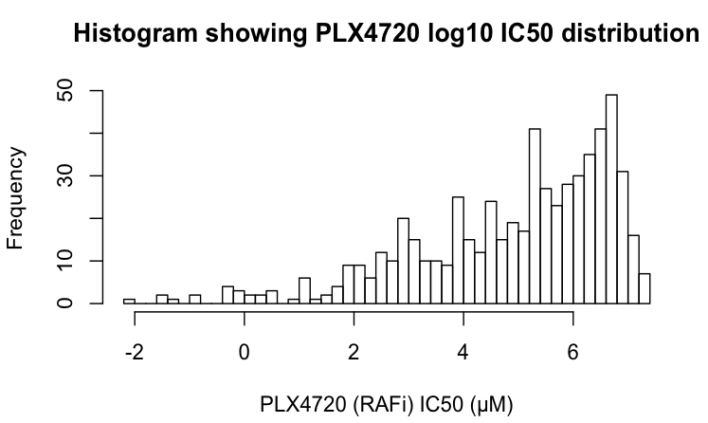
Test BRAF/RAFi Association
Spearman Rank Correlation

Slide 15
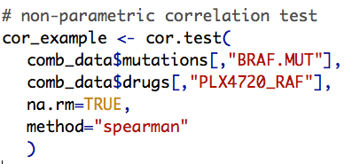
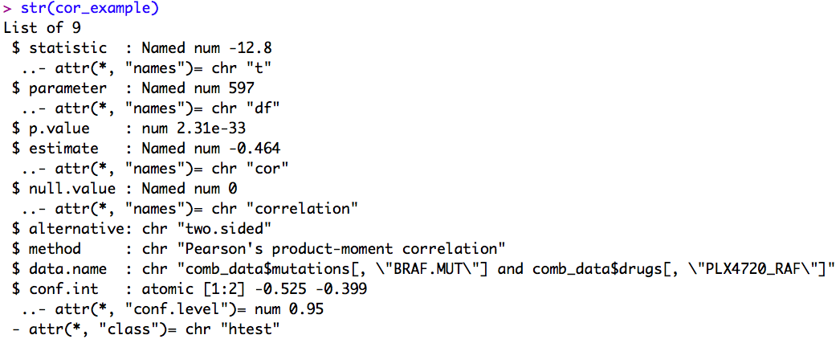
Test BRAF/RAFi Association
Spearman Rank Correlation

Slide 16
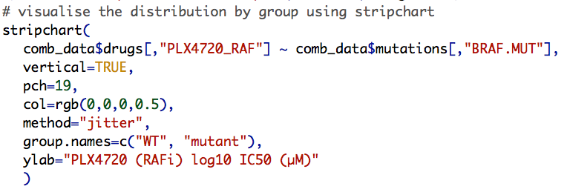
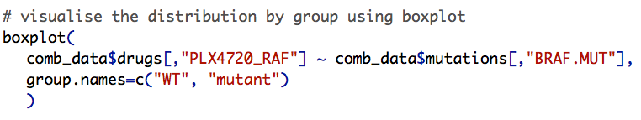
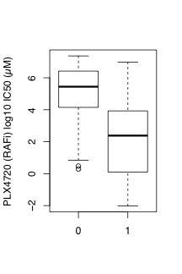
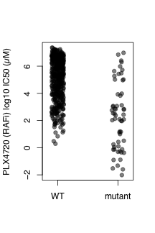
Test BRAF/RAFi Association
Spearman Rank Correlation

Slide 17
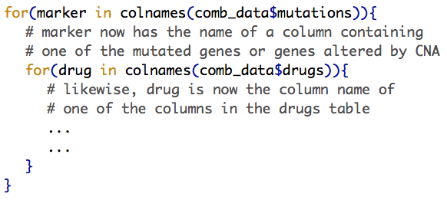
Test all gene/drug associations
Looping and cor.test()
Do something here that operates on the columns from the drug and mutation data tables.

Slide 18
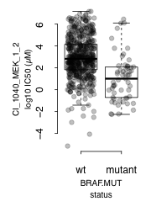
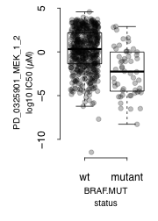
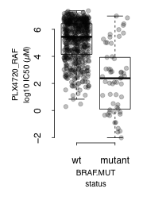
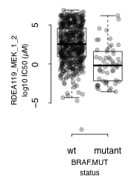
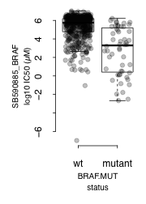
Visualise a subset of statistically significant gene-drug associations
Boxplot by mutation status
BRAF mutation correlates with sensitivity to multiple RAF and MEK inhibitors

Slide 19
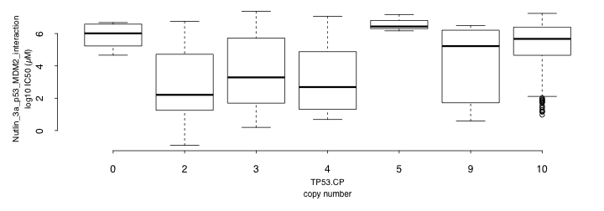
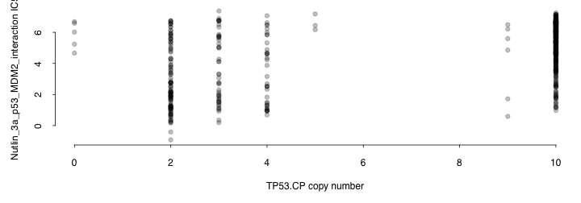
Visualise a subset of statistically significant gene-drug associations
Boxplot by copy number
TP53 deletion correlates with resistance to nutlin (r=0.43, p=6.5e-29)

Slide 20
Sum up
Useful sources of information
R books
Papers
Stack Exchange… Google

